Slide 1
Software Economics
Business aware software development
Notes:
Build SW focused on business
SW in delivery phase (not discovery phase) -> Delivering value

Slide 2


Original Speakers

Slide 3
Andrés Miguel Terán
Carmen Domínguez
Josu Escalada

Slide 4
Business needs
Value, Cost, Risk & Debt
Iterative & incremental
Change & evolution
Design
Notes:
Connect “Business needs” with “SW Design”

Slide 5
Business people don’t understand us
But, do we understand them?
Let’s talk in the same language to improve communication and trust.
Notes:
Stop complaining about it, do you understand them?
Let’s talk in economic language.

Slide 6
Business mindset
“Reformulate the benefits of using good practices in terms that make sense for the business.”

Slide 7
We are here to satisfy business needs
Early delivery of VALUE, | Return on investment (ROI) Hypothesis validation Risk reduction …
With the lowest possible COST,
Keeping OPTIONS open, | So that RISK is reduced (To be able to face uncertainty)
With DEBT under control, | To avoid being unable to pay it off in the future

Slide 8
Business needs
Value, Cost, Risk & Debt
Iterative & incremental
Change & evolution
Design

Slide 9
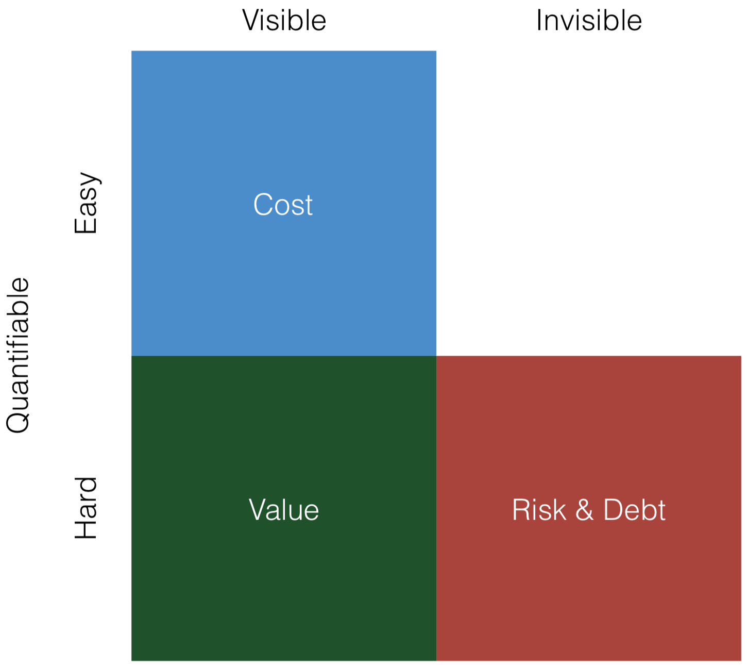

Slide 10
Business needs
Value, Cost, Risk & Debt
Iterative & incremental
Change & evolution
Design

Slide 11
Waterfall

Slide 12
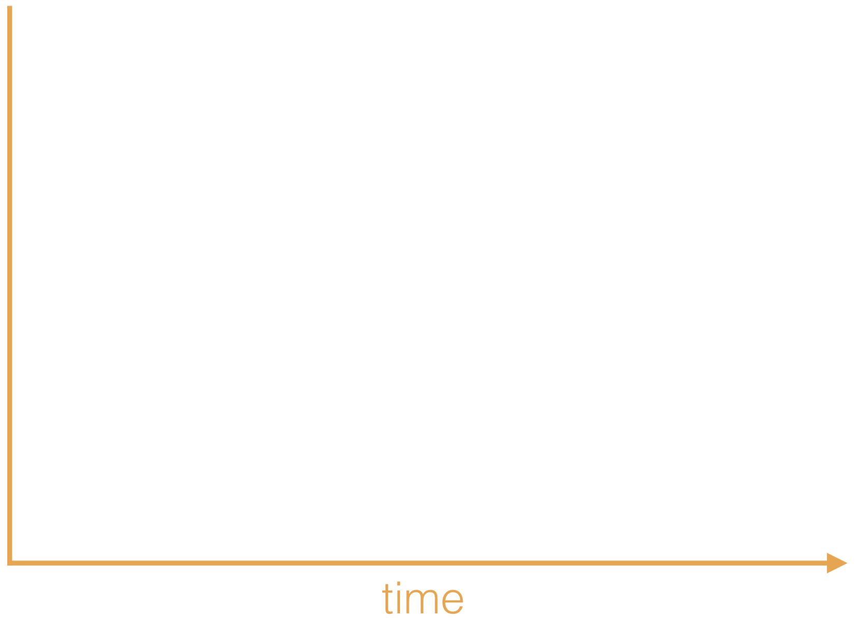

Slide 13
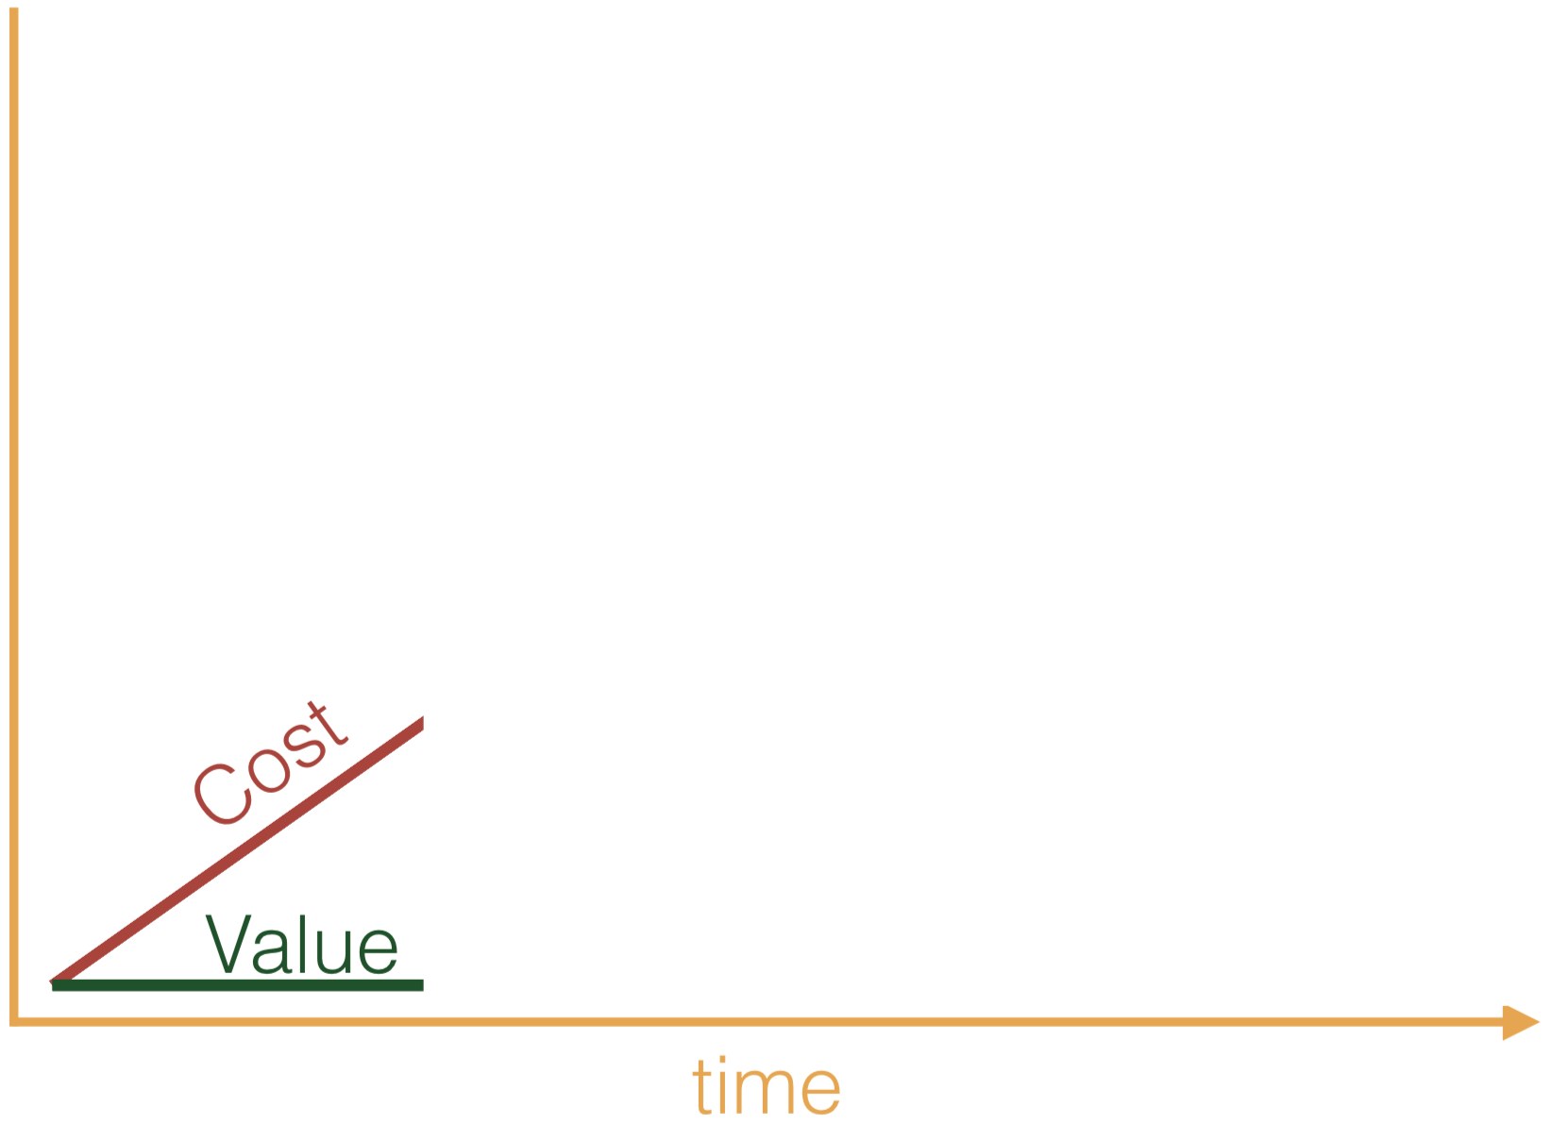

Slide 14
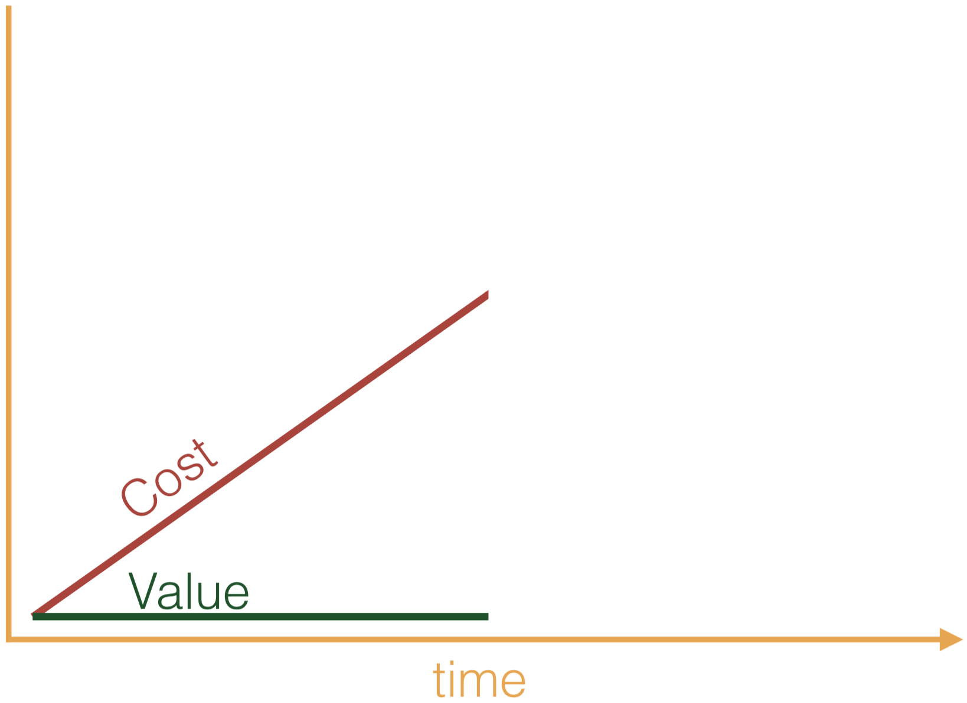

Slide 16
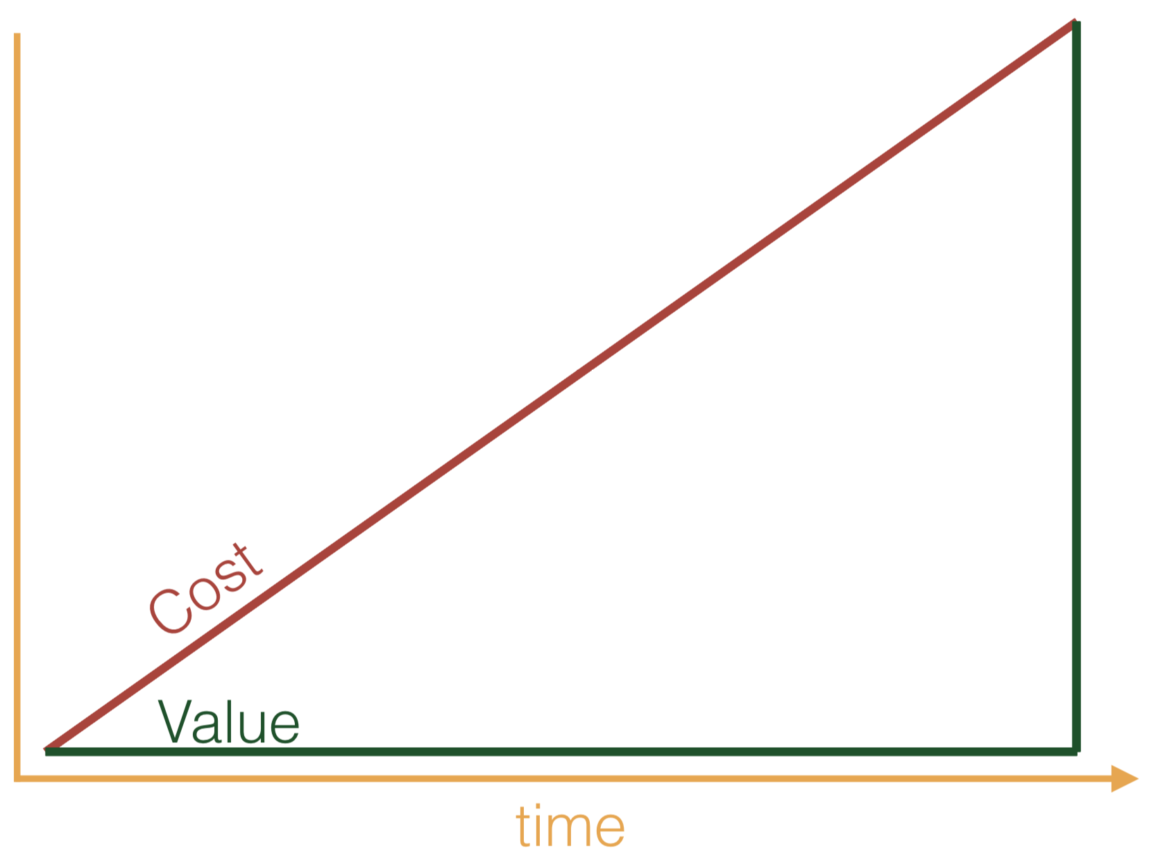

Slide 17
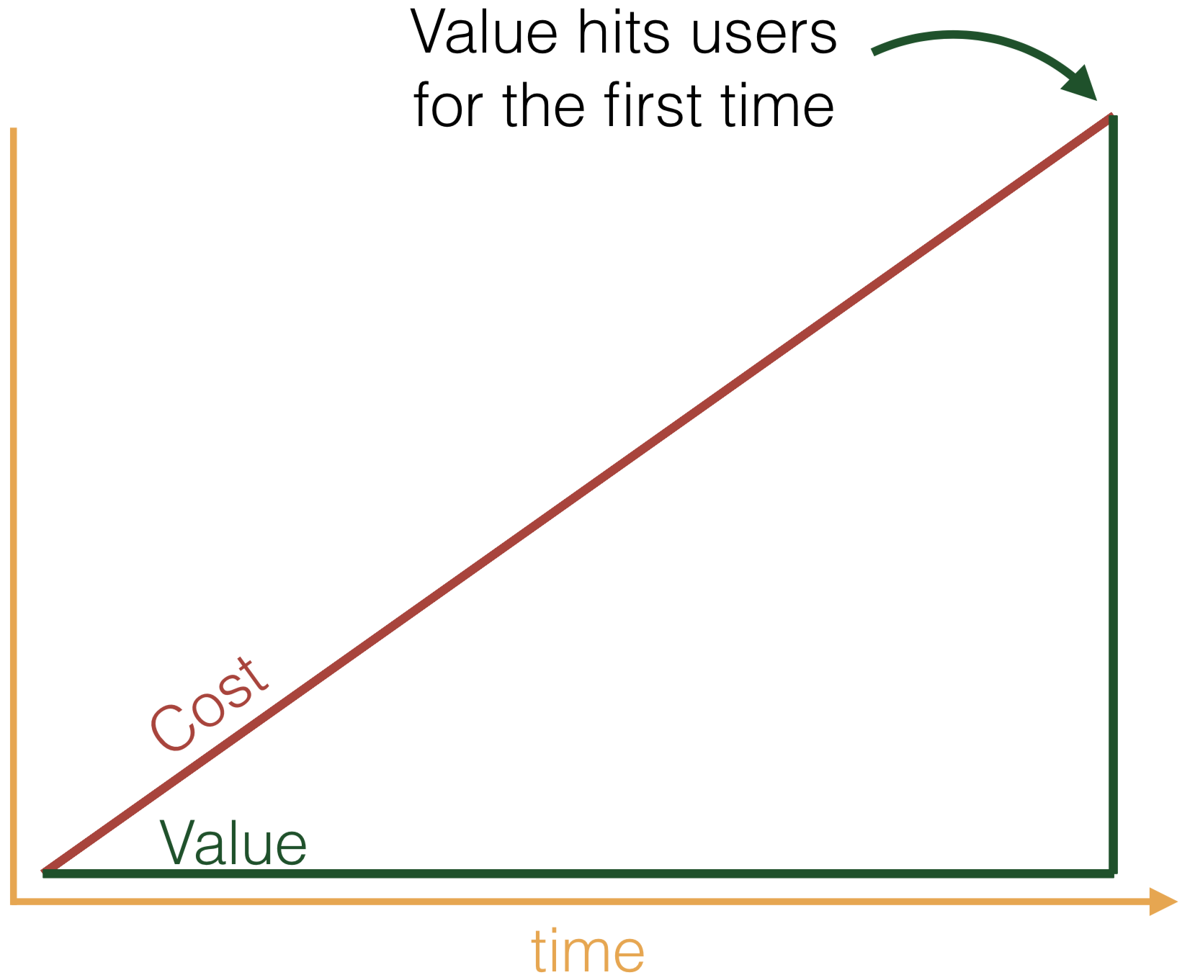

Slide 18
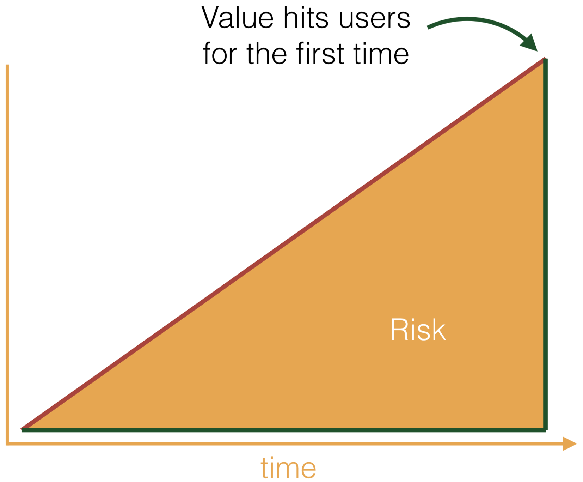

Slide 19
Iterative & incremental Value, Risk & Debt over Cost
Notes:
High risk as we don’t get feedback

Slide 21
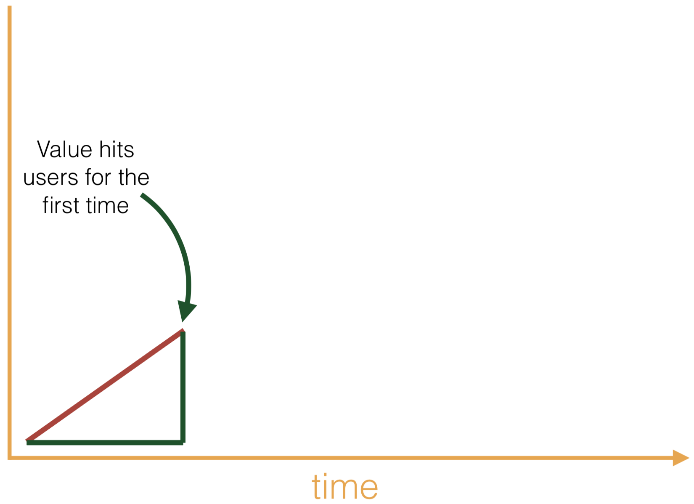
Notes:
Complete exercise of Analysis, Design, Implementation and Testing.

Slide 22
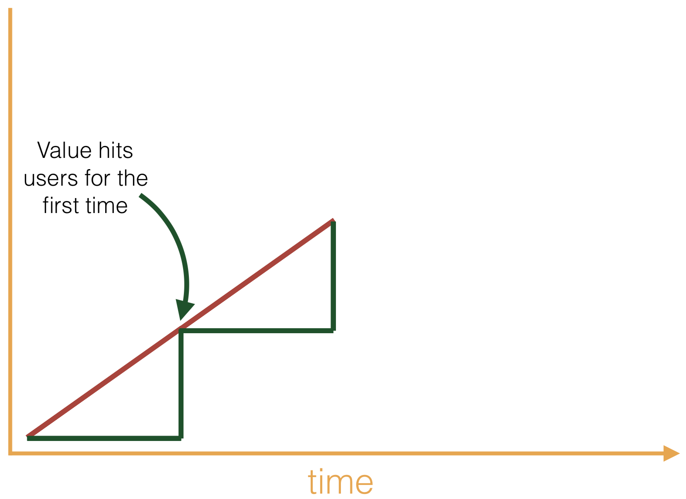

Slide 23
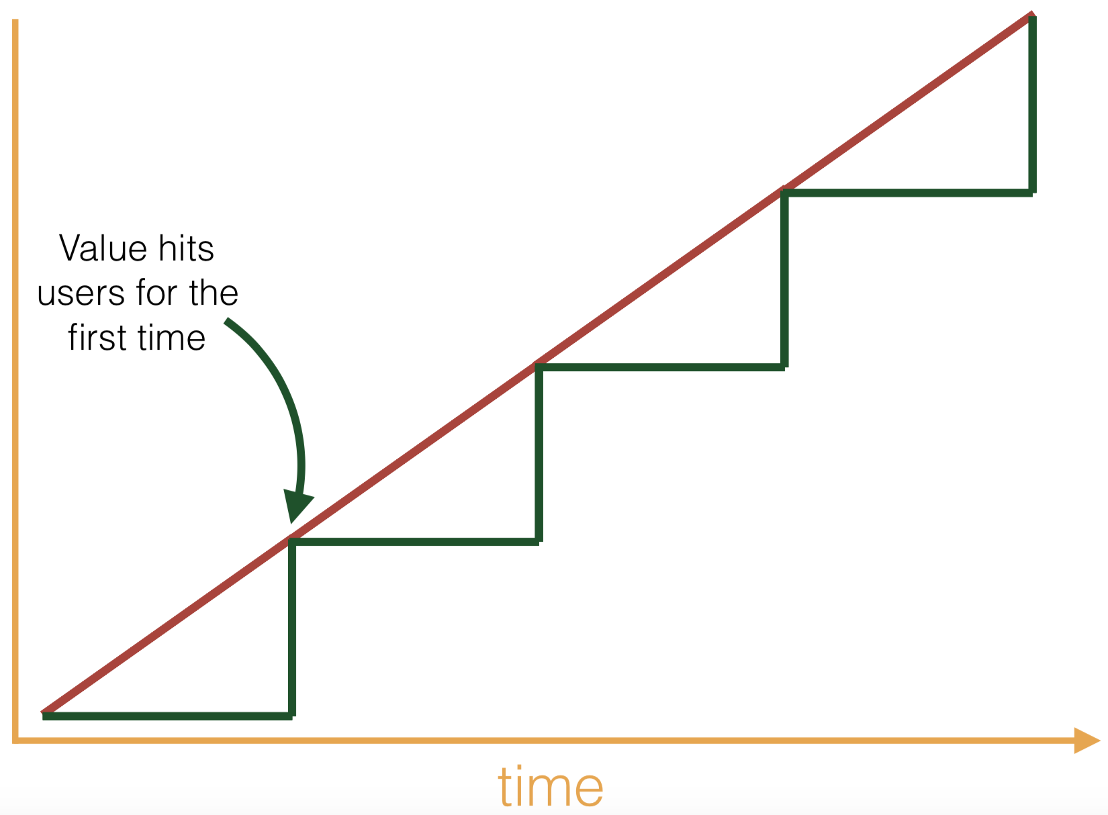

Slide 24
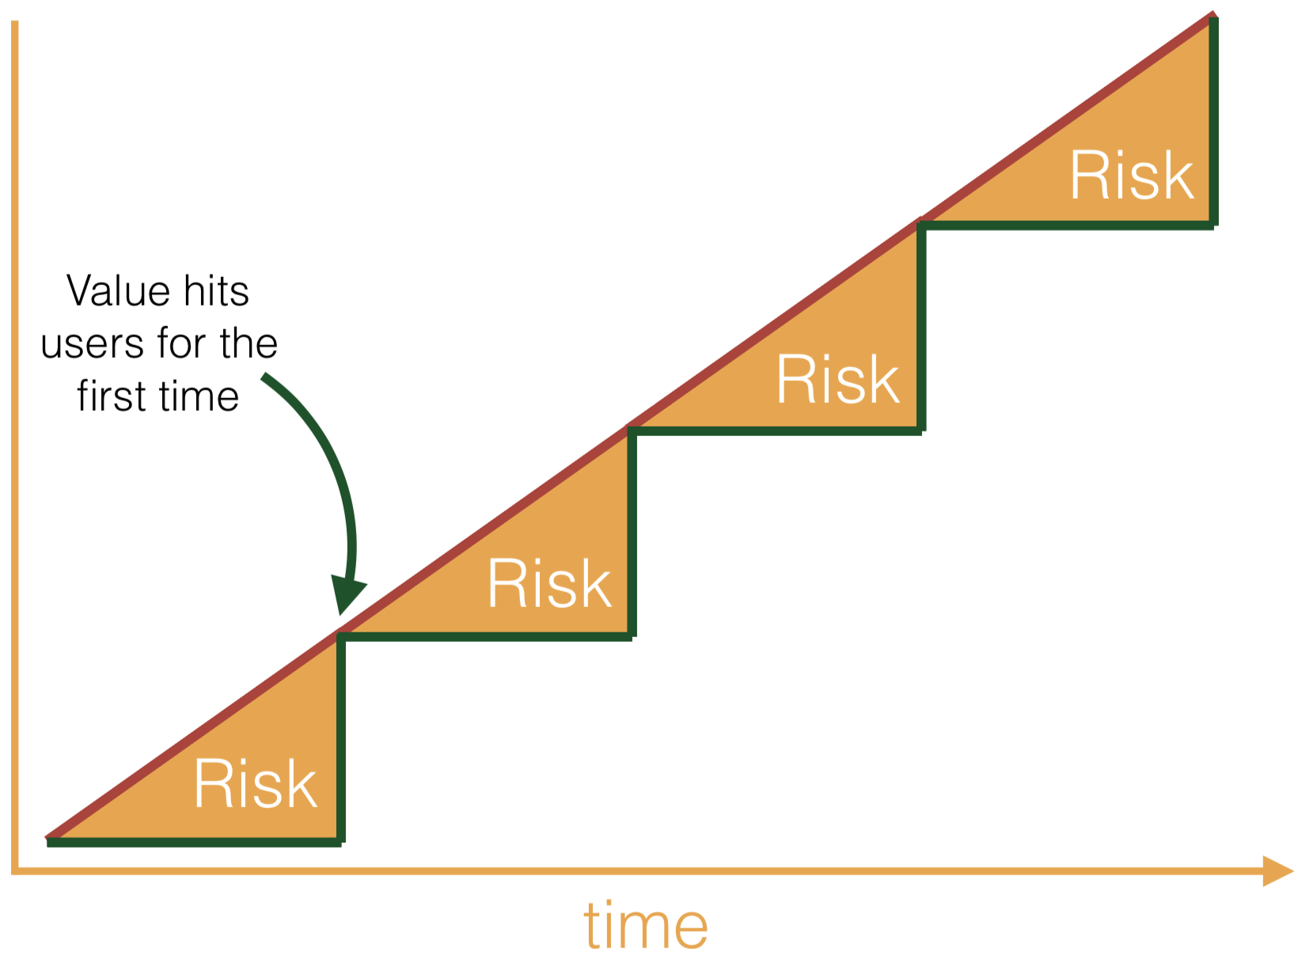

Slide 25
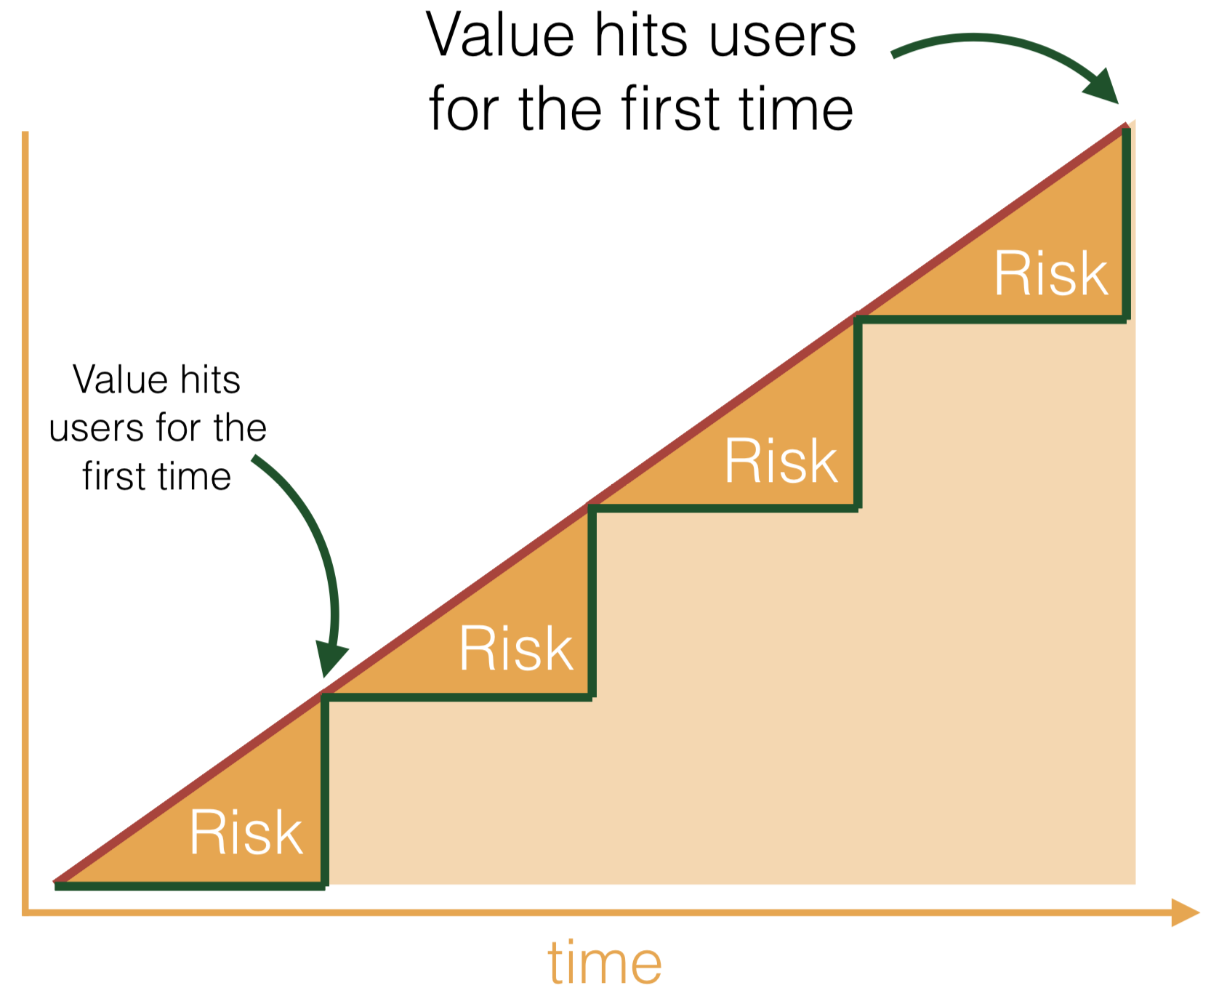

Slide 26
Business needs
Value, Cost, Risk & Debt
Iterative & incremental
Change & evolution
Design

Slide 27
Evolving a feature
Notes:
Evolving a feature means facing new economic challenges

Slide 28
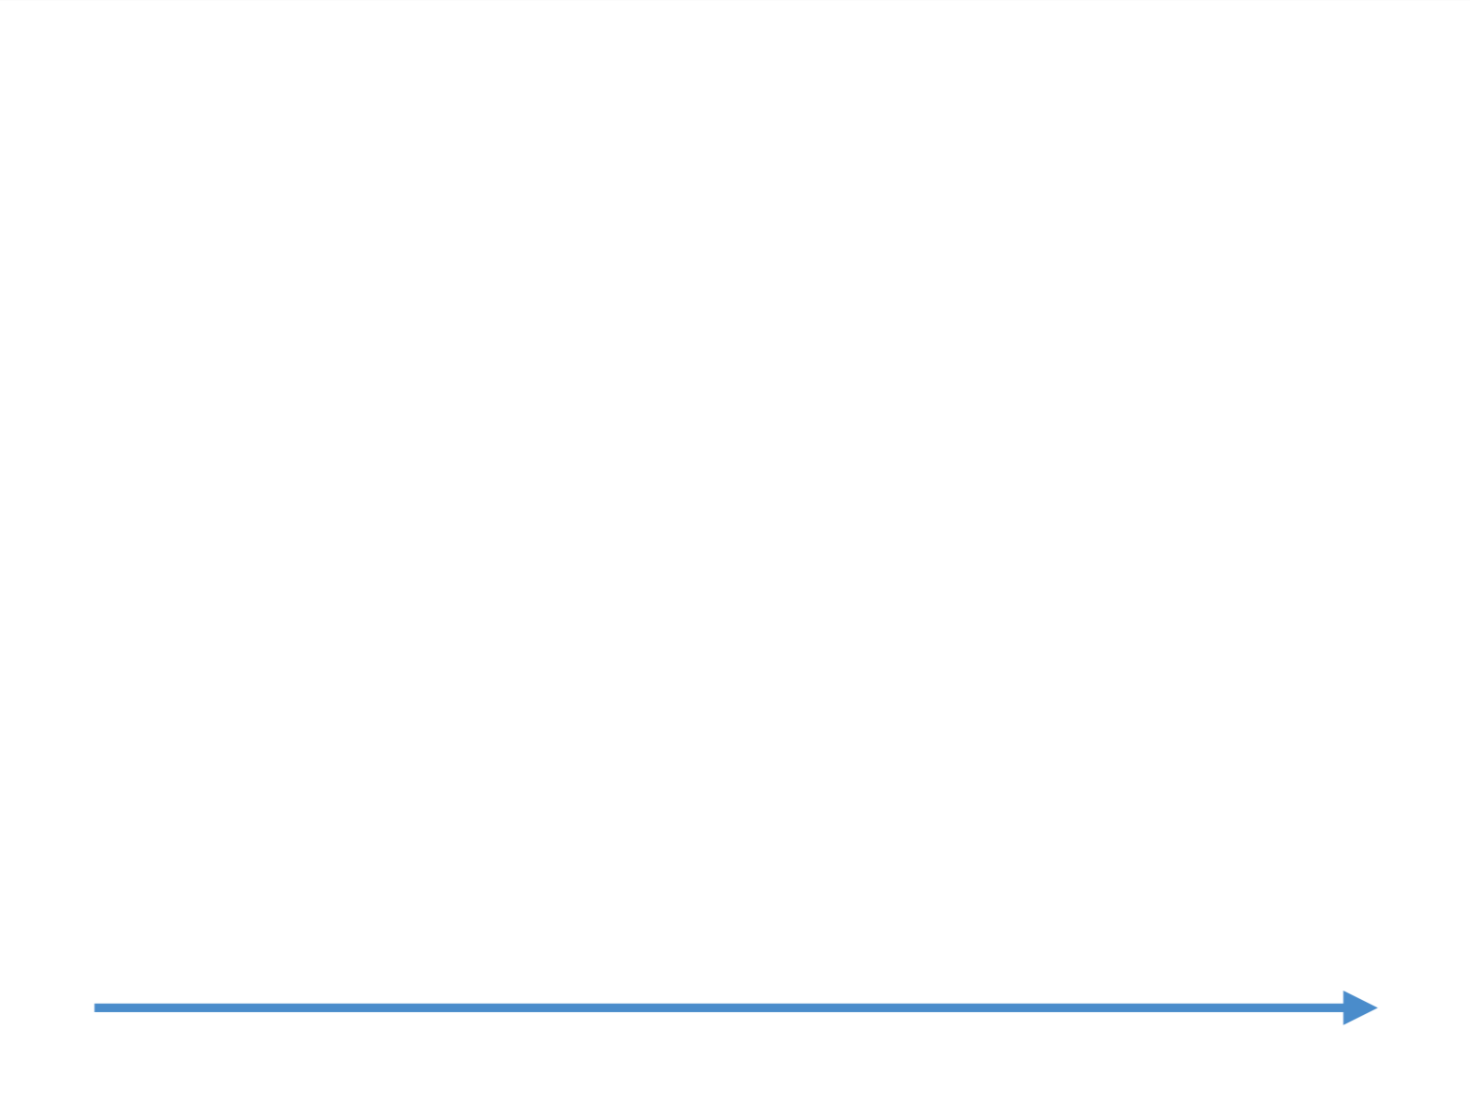

Slide 29
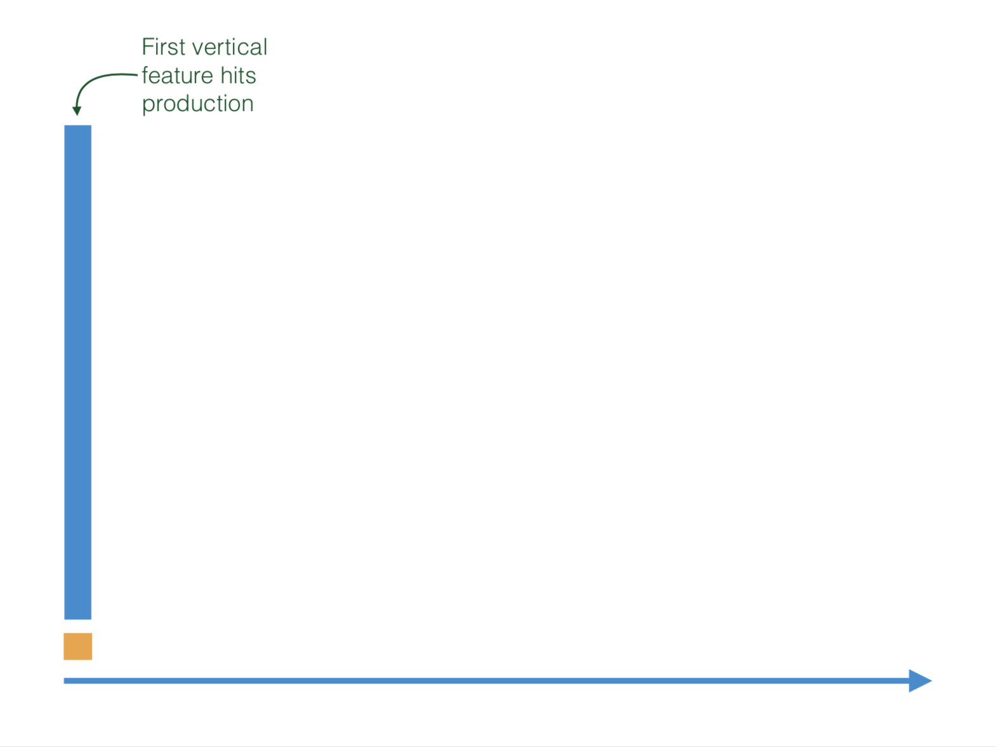
Notes:
Evolving a feature:
Identify small vertical functional features to hit production. This means delivering something at the end of the iteration.
We get feedback early and fast, reduce risk and we add value.

Slide 30
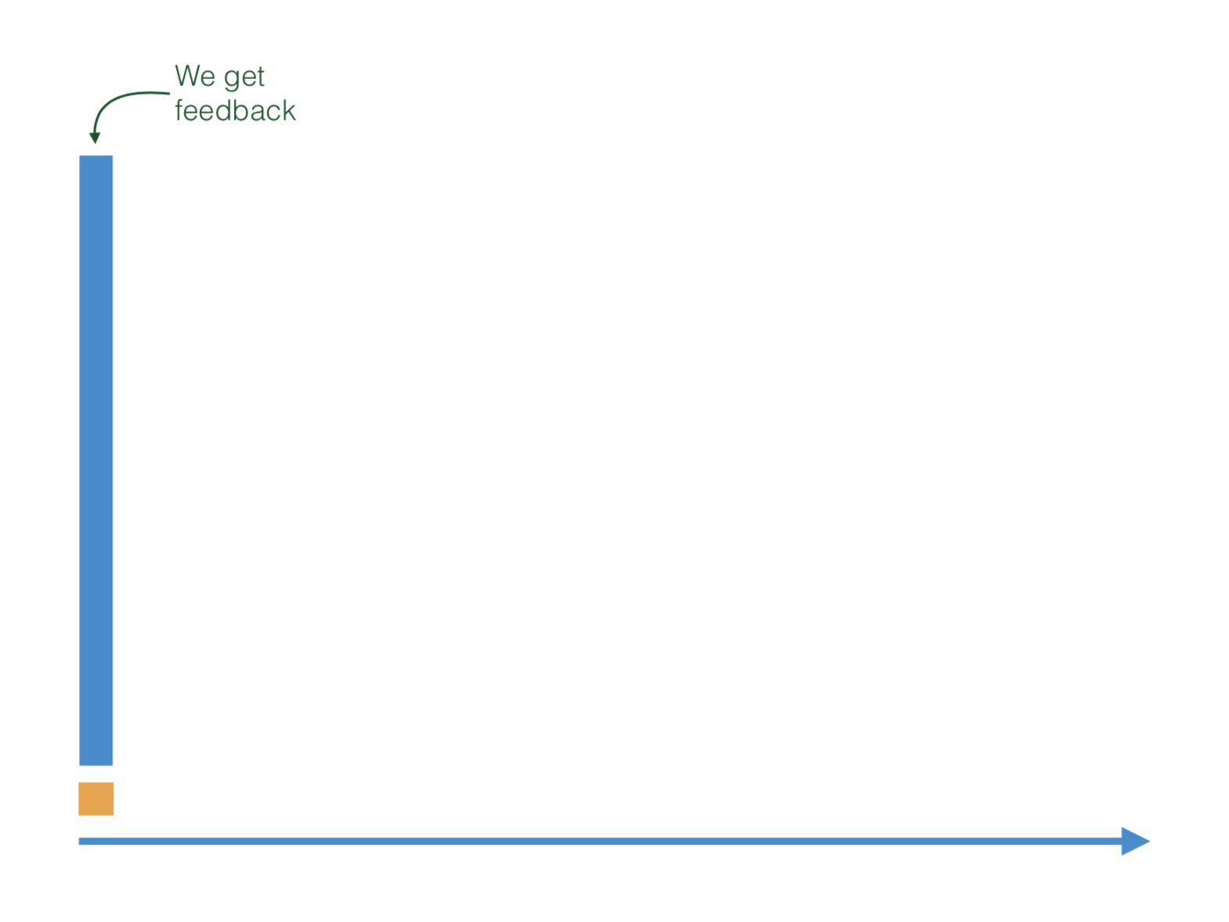

Slide 31
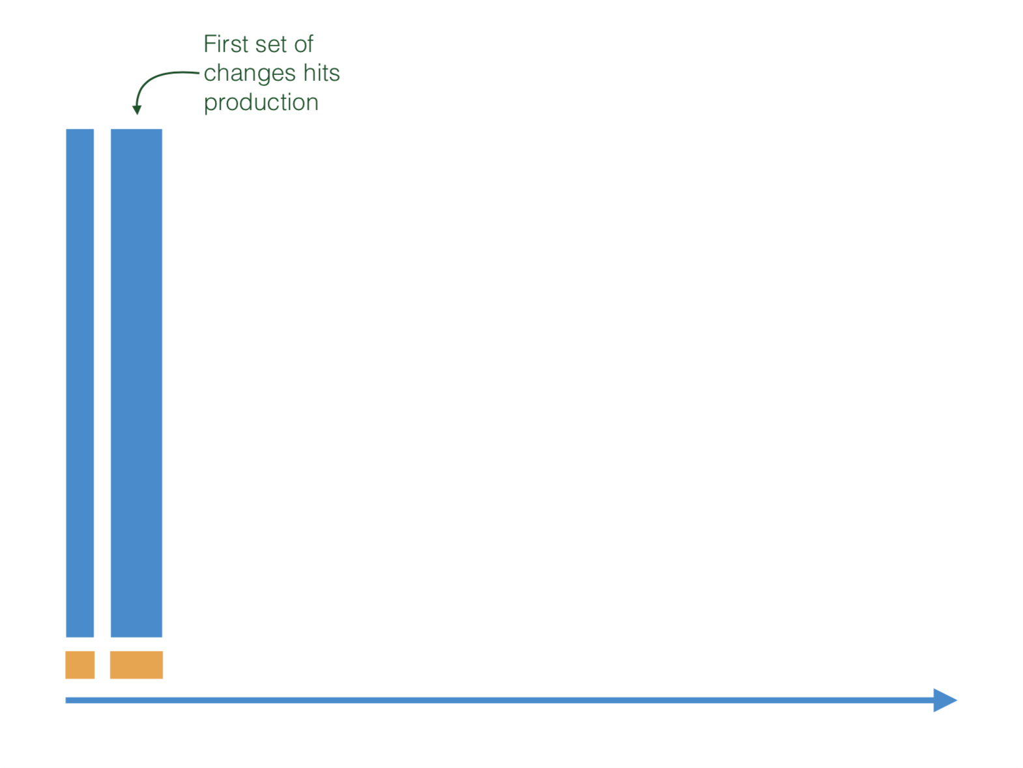
Notes:
1st set of changes
Each iteration means:
Improve previous code with feedback + adding new features

Slide 32
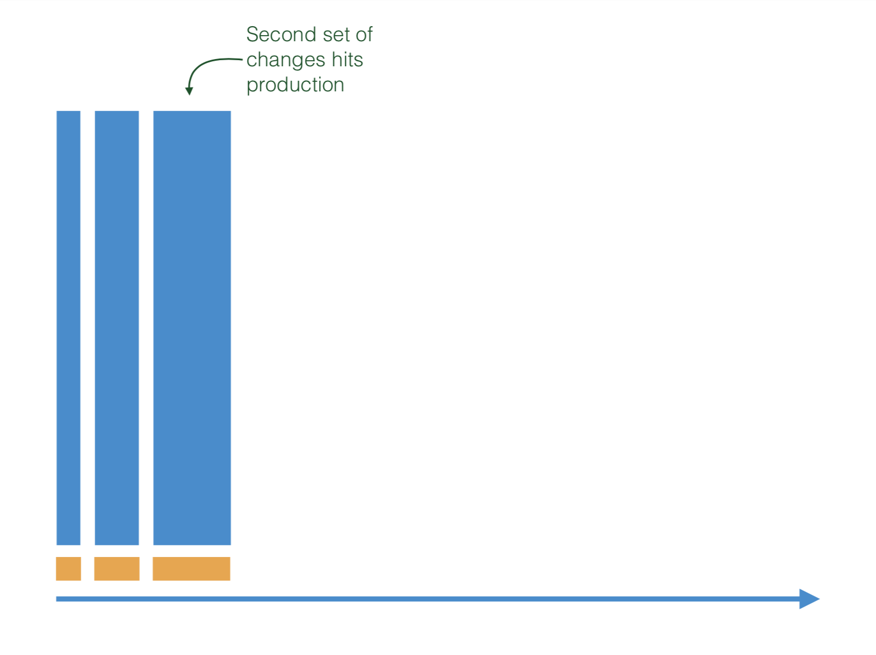

Slide 33
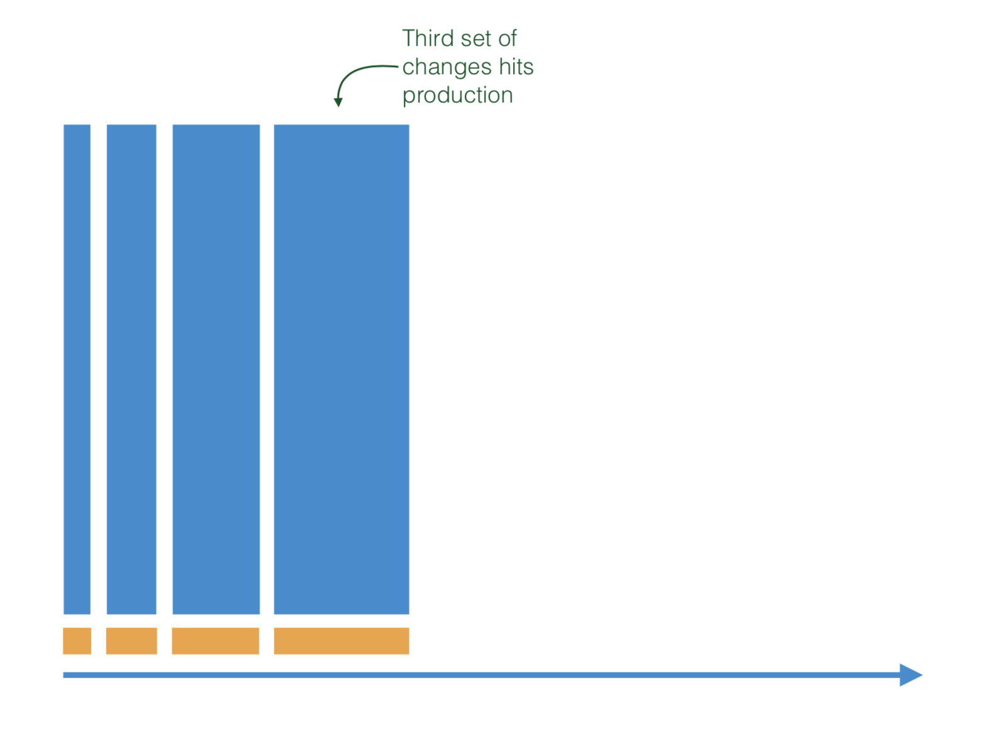

Slide 34
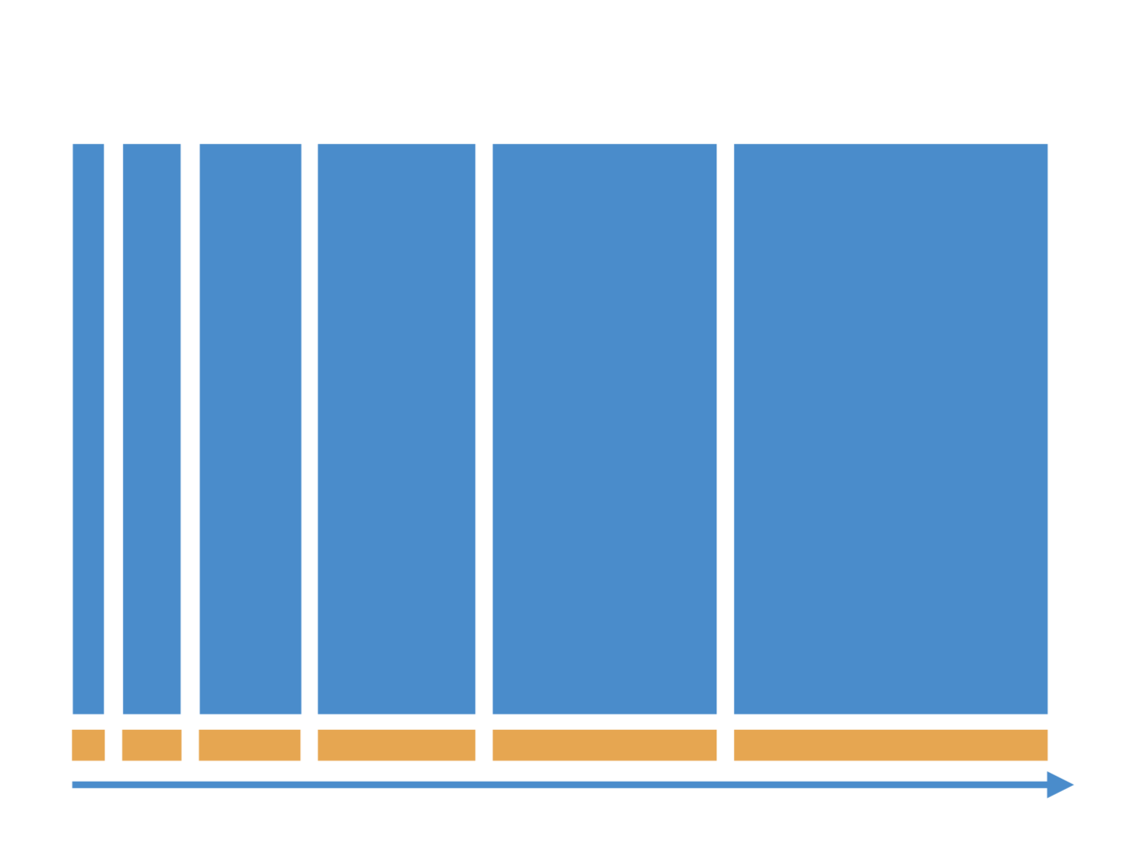

Slide 35
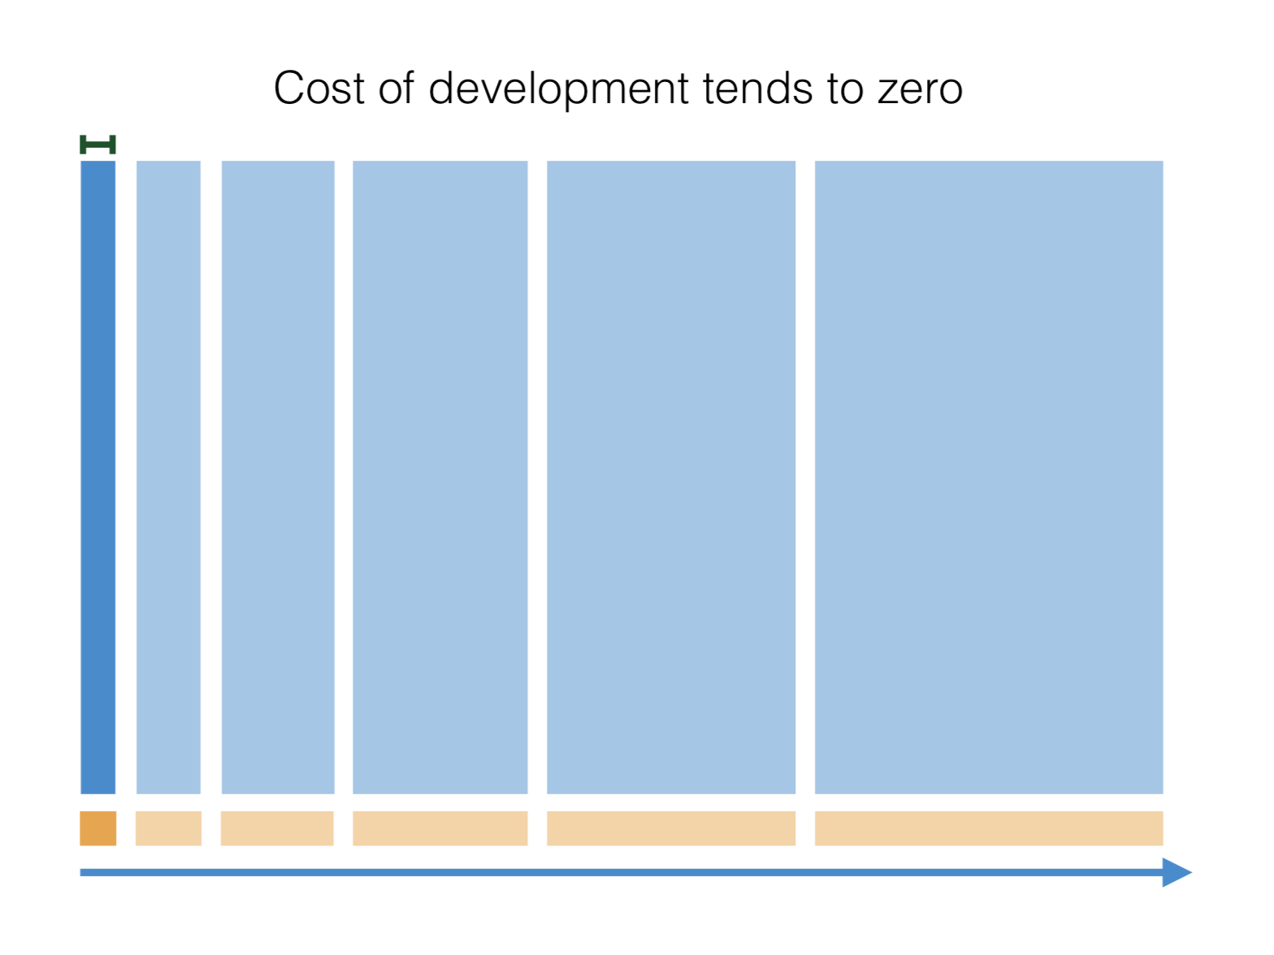
Notes:
Cost of first development tends to 0 compared to evolving it.

Slide 36
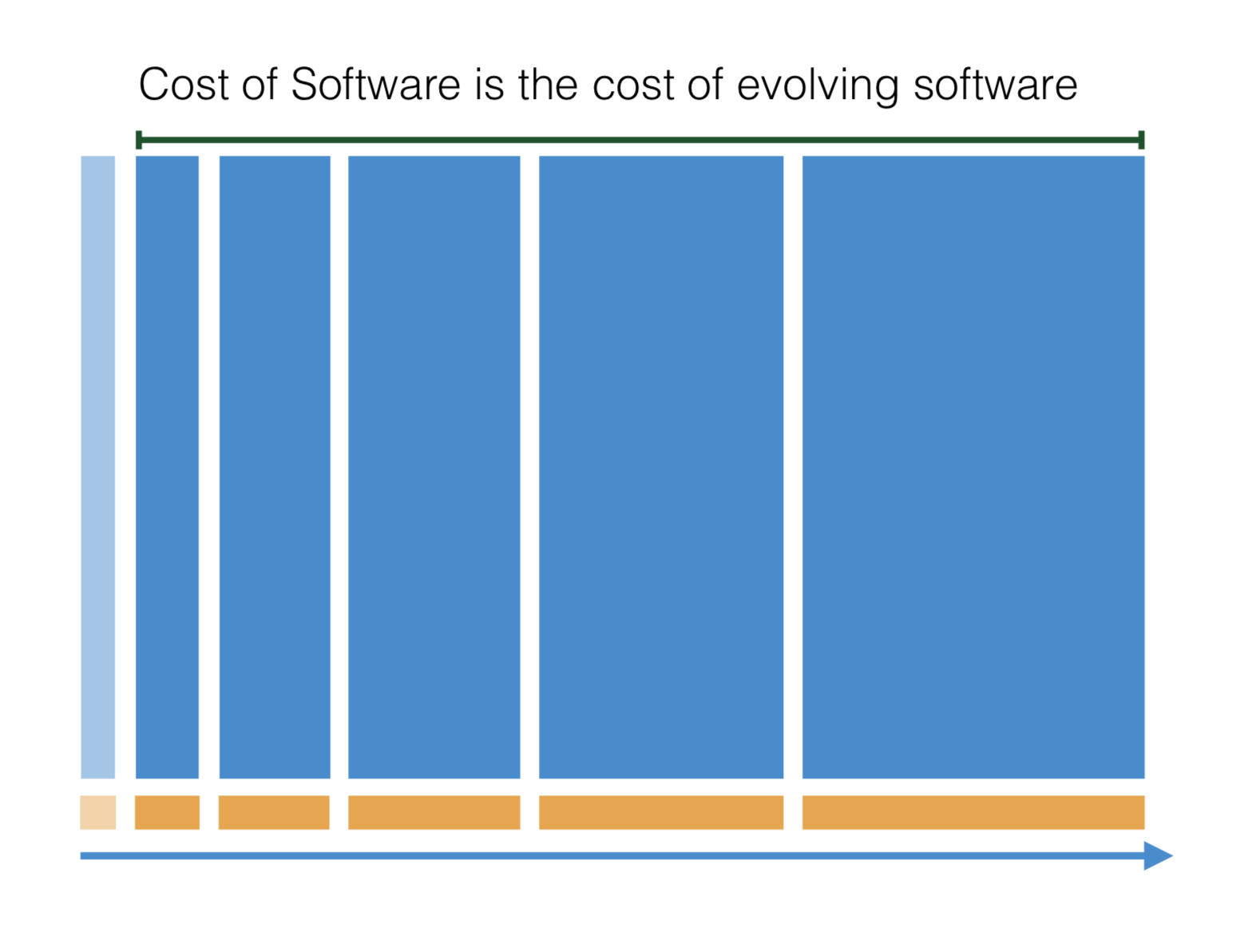

Slide 37
Testing Challenge of reliable continuous delivery

Slide 38


Slide 39
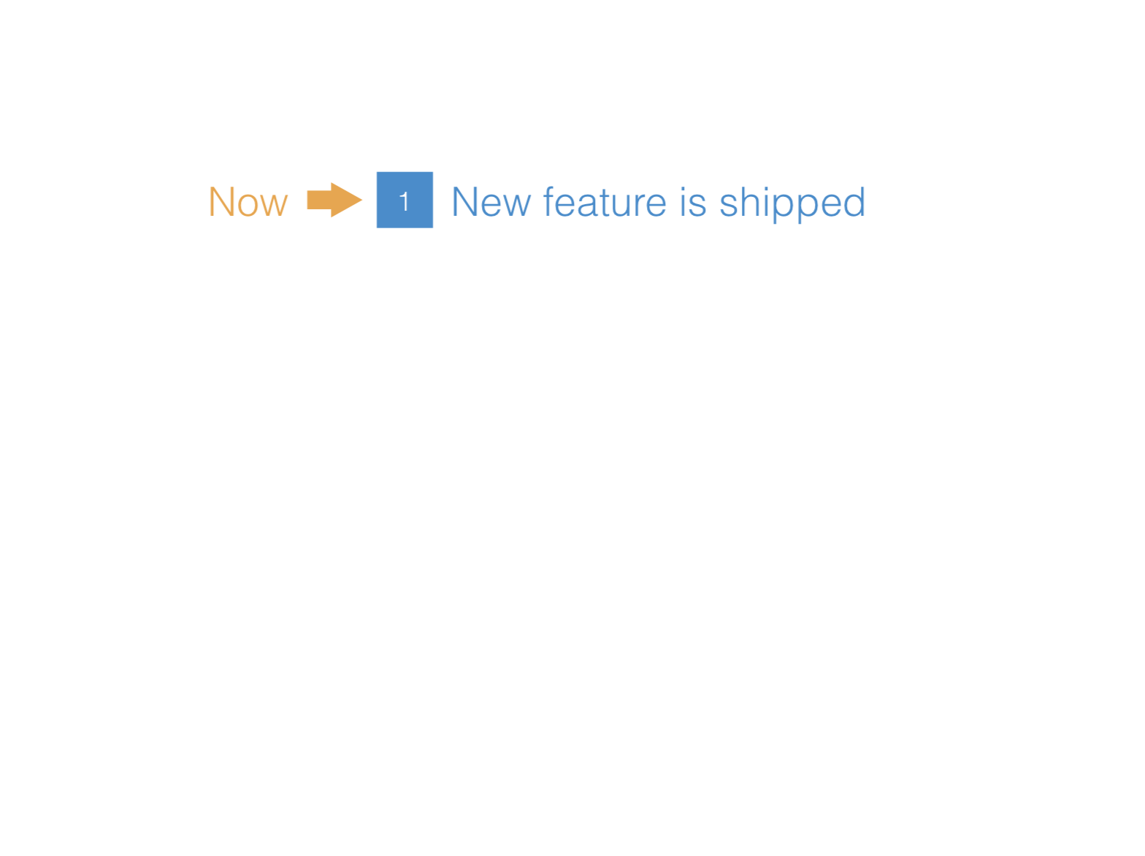

Slide 40
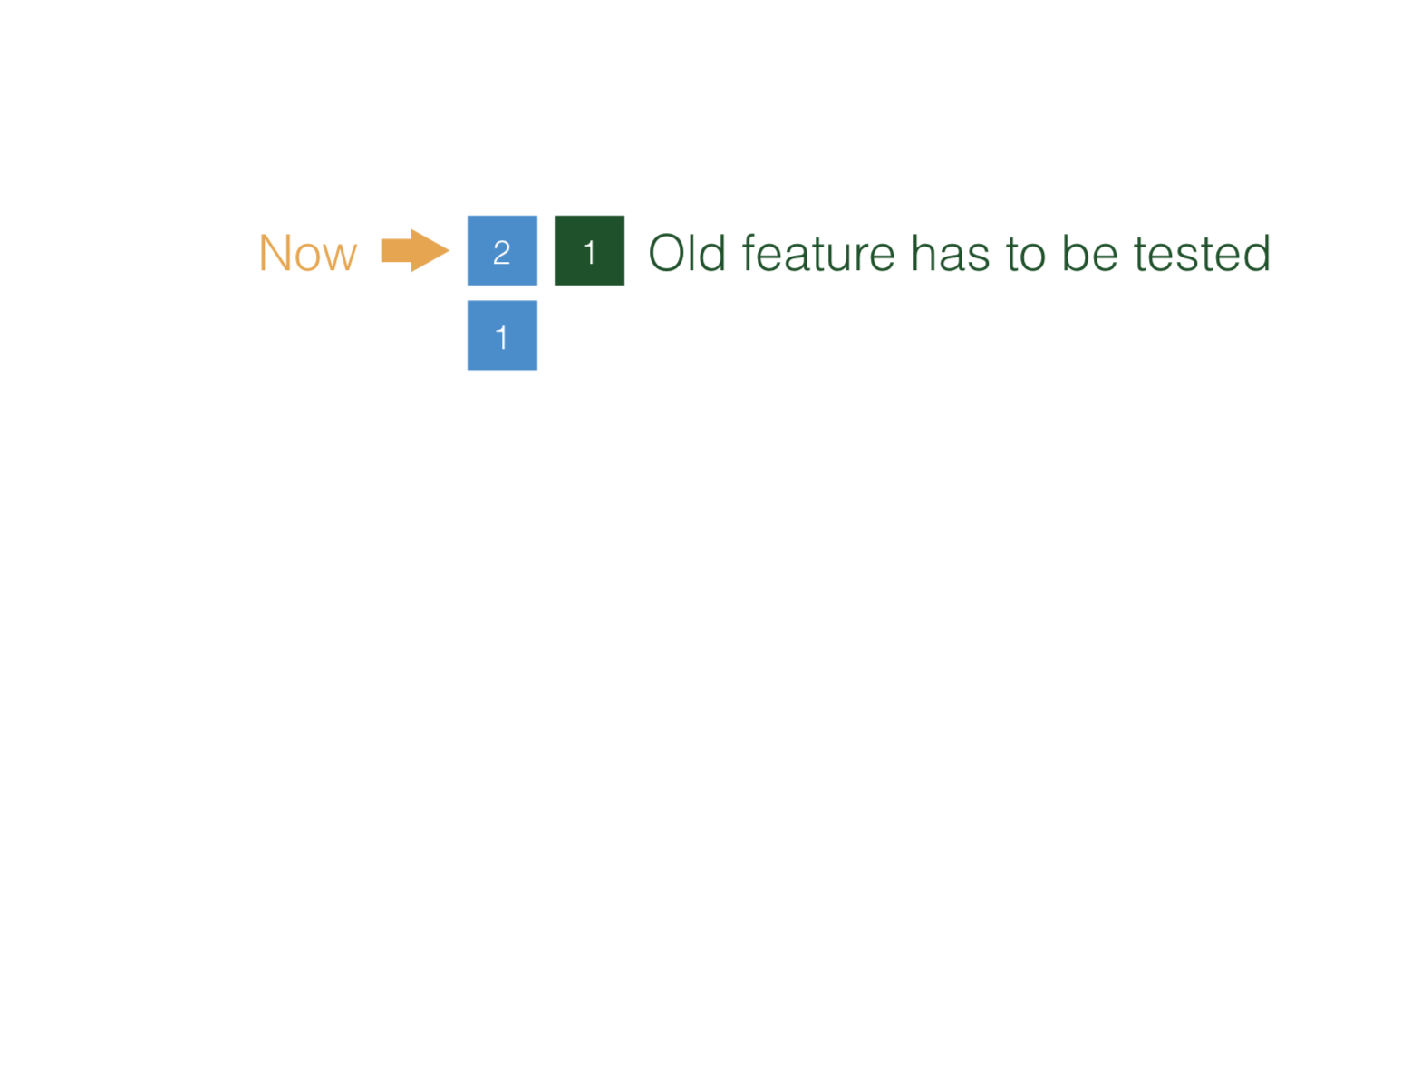

Slide 41
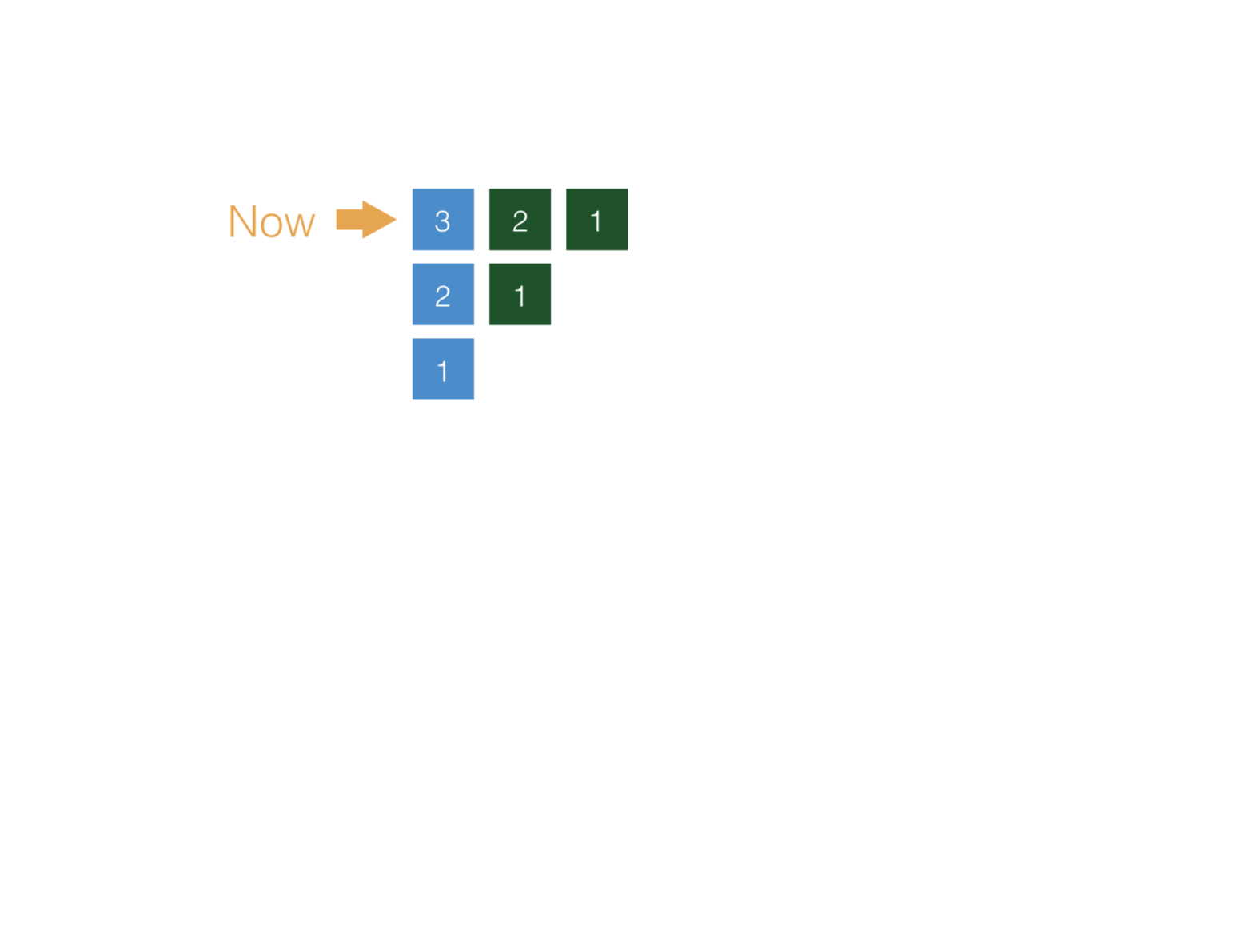

Slide 42
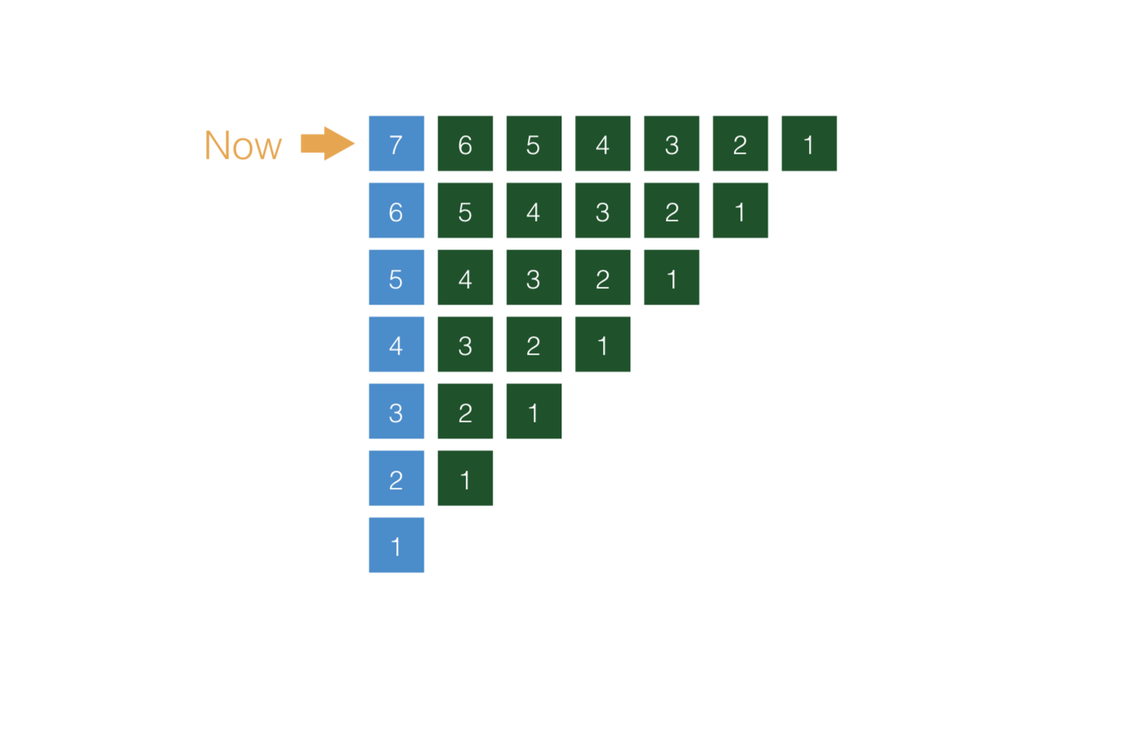

Slide 43
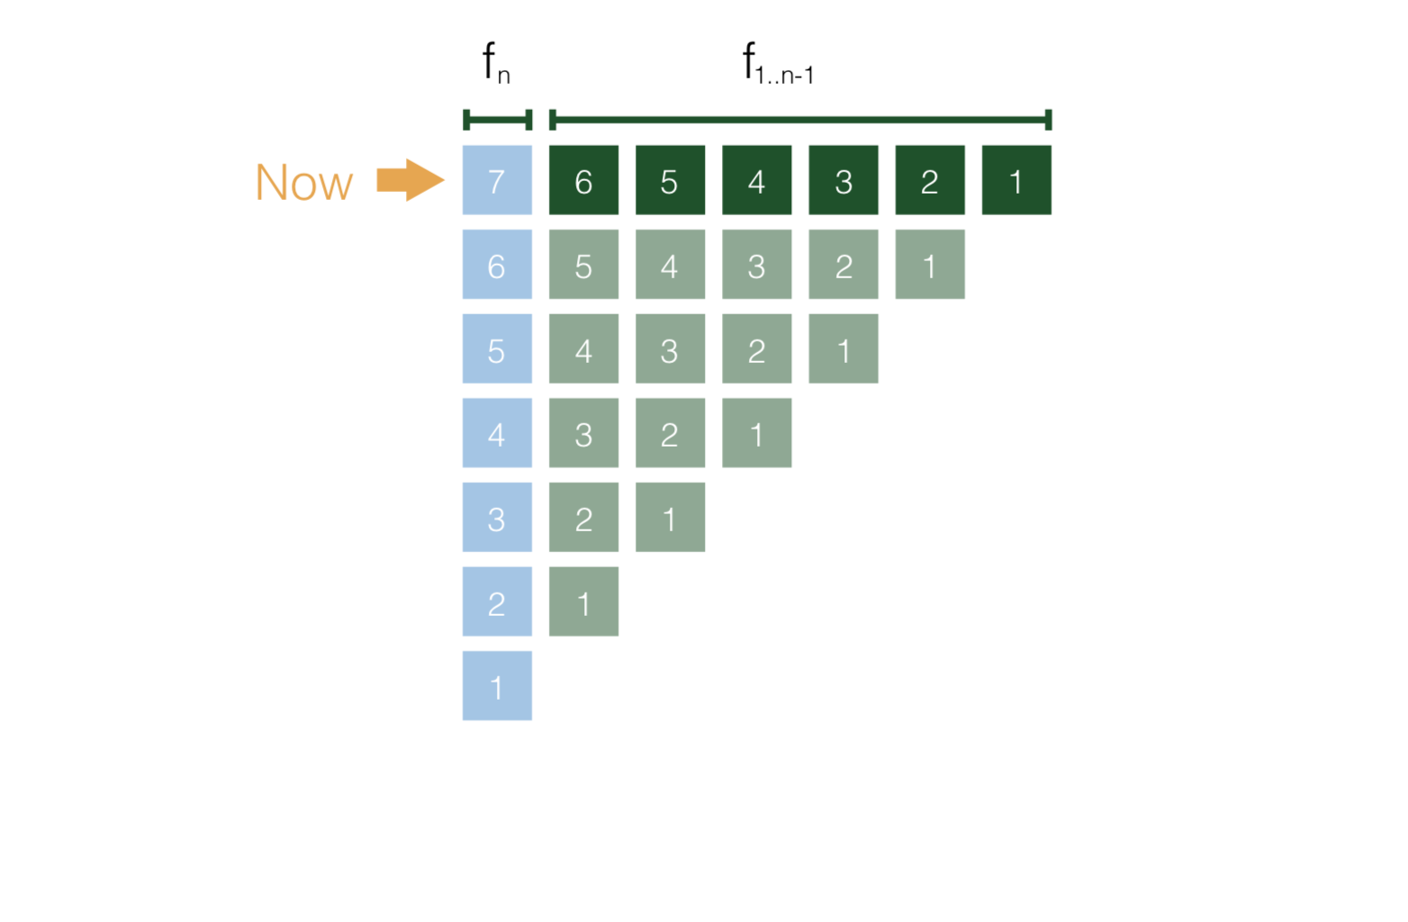

Slide 44
Business needs
Value, Cost, Risk & Debt
Iterative & incremental
Change & evolution
Design

Slide 45
Technical & non-technical people working together to achieve a goal
Taking technical decisions depending on value/cost/risk/debt.
Think in increasing VALUE, reducing RISK and DEBT, “forgetting” about COST.
How we develop has an impact on the economy of the project.

Slide 46
Economic team activities
Risk driven | Architecture Knowledge sharing …
Debt driven | Refactoring
Cost driven | Software design Delivery automation
Value driven | Discovering features with a big impact

Slide 47
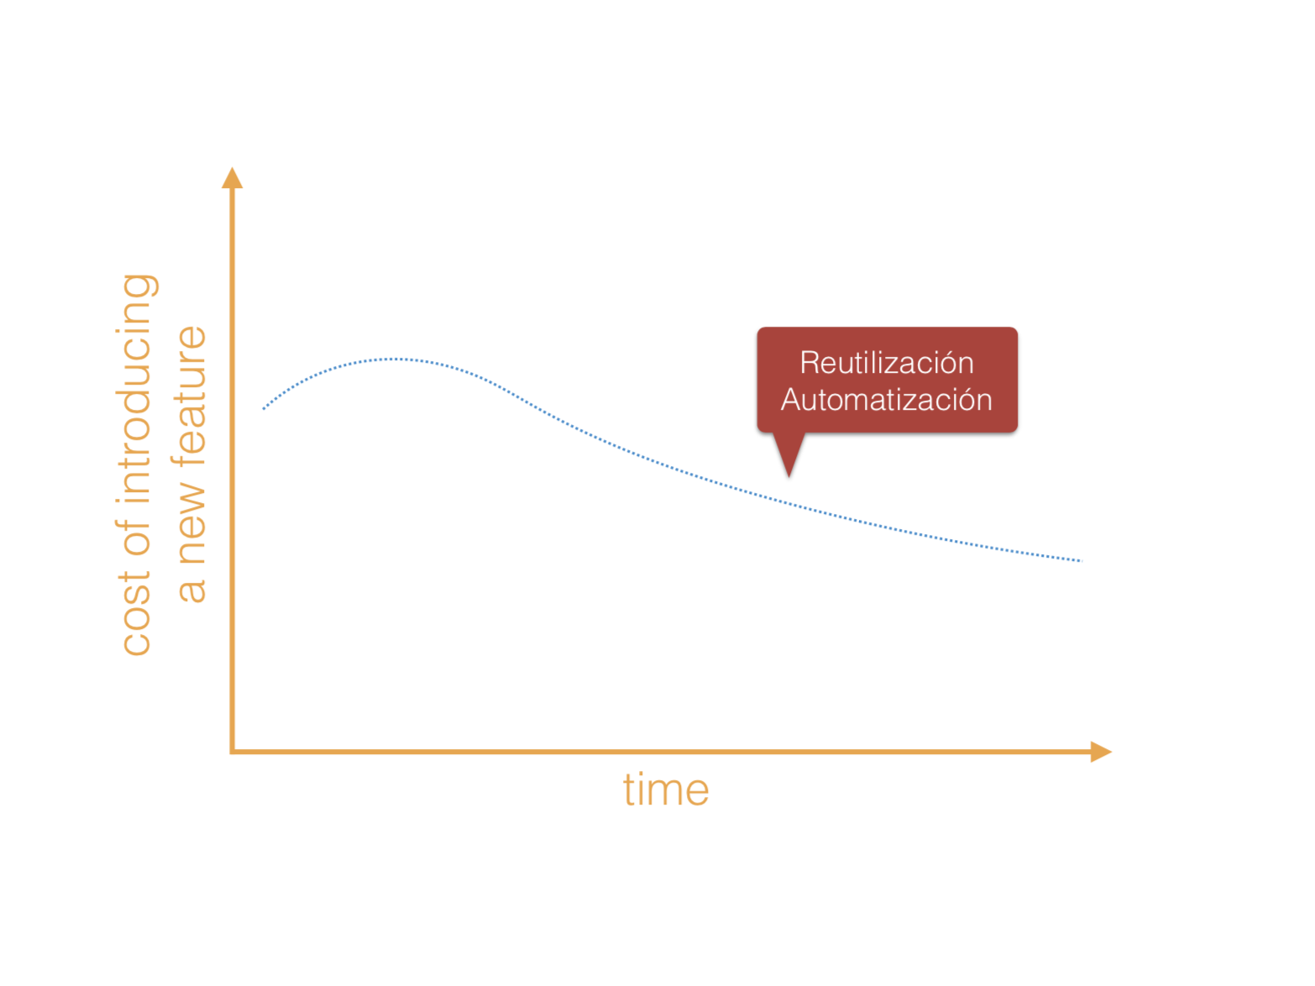
Notes:
Economics of Scale (the more you do, the less it costs)

Slide 48
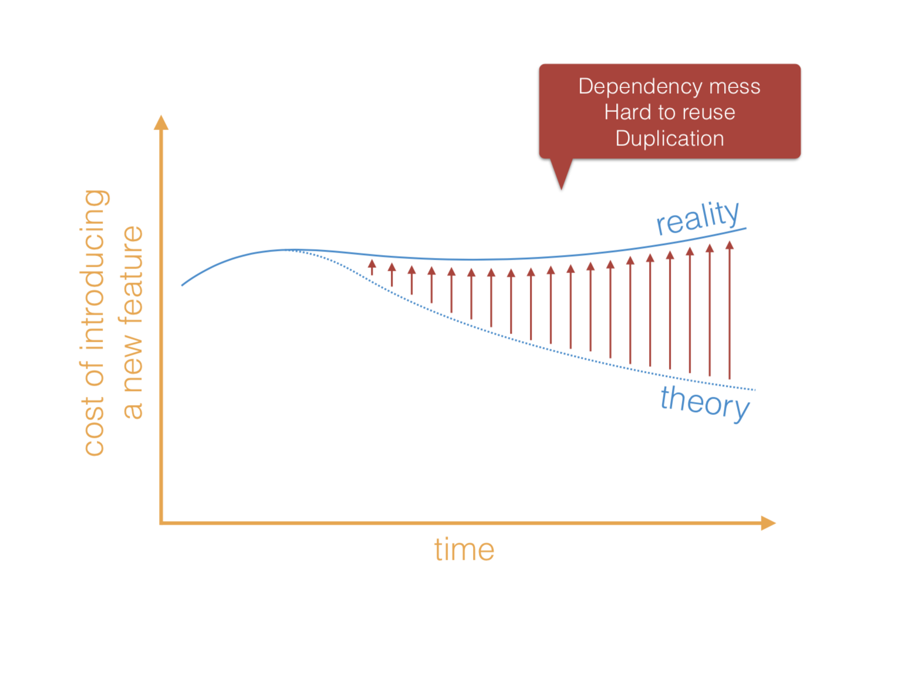
Notes:
Dependency mess
Hard to reuse
Duplicates (If you copy-pasted, this means changing things in more than 1 place)
No tests
Change 1 component used everywhere

Slide 49
Conclusions
Care about business and talk in a common language.
Care about Value / Cost / Risk / Debt.
If you develop like this…
Iterative & incremental
If so…
Be ready for continuous changes
Those changes could mean increasing the cost…
The key: Good SW design!
SW Design
Focus on building software easy to change.

Slide 50
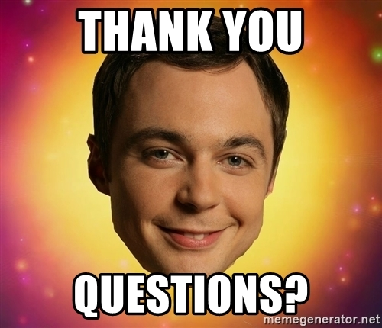

Slide 51
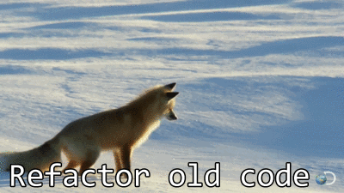

Slide 52


